Slide 1
Customer Support Chat bot with ML
VIVA-VOCE
Batch Number: CAI-G05
Under the Supervision of,
Dr. Swati Sharma
Associate Professor - Selection Grade
School of Computer Science & Engineering
Presidency University
Roll Number | Student Name
20211CAI0065 20211CAI0147 20211CAI0175 20211CAI0076 20211CAI0064 | SIRI H G PAVAN S REDDY MOULYA H M E BHAVANI S SANJANA
Name of the Program: Bachelor of Technology
Name of the HoD: Dr. Zafar Ali Khan N
Name of the Program Project Coordinator: Dr. Afroz Pasha
Name of the School Project Coordinators: Dr. Sampath A K / Dr. Abdul Khadar A / Mr. Md Ziaur Rahman

Slide 2
Introduction
A very advanced solution for automating customer care is a Customer Support Chatbot with Machine Learning that can analyse client complaints or queries and actively learn from encounters.
This chatbot can evaluate consumer questions, look up possible answers in its database, and offer prompt support.
It easily moves the case to human support personnel when a novel or complicated problem emerges.
When the staff fixes the problem, the chatbot gains knowledge from the exchange, adds the updated solution to the database, and gets ready to answer similar questions in the future.
In addition to increasing response speed and accuracy, this technology guarantees ongoing learning and development, which gradually makes customer support more knowledgeable and flexible.

Slide 3
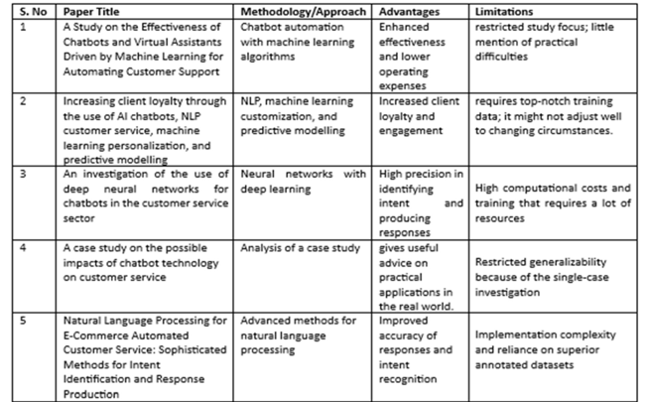
Literature Review

Slide 4
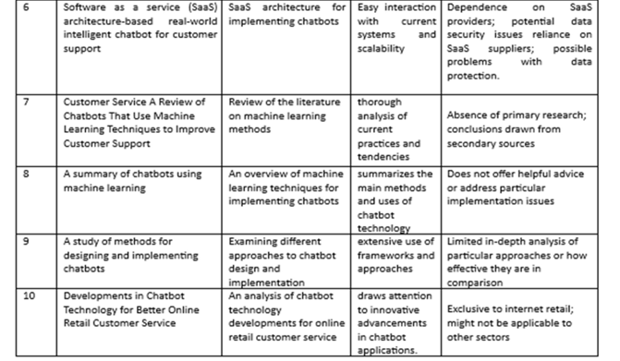
Literature Review contd..

Slide 5
Research Gaps Identified
Poor context retention in multi-turn chats.
Limited multilingual capabilities.
Struggles with ambiguous inputs.
Reliance on static data; needs frequent retraining.
Weak security for data protection.
Lacks emotional intelligence for empathy.
Insufficient domain-specific expertise.

Slide 6
Proposed Method
Advanced NLP and ML: Handles queries across languages and complexities.
Instant Answers: Searches a dynamic database for prompt responses.
Human Escalation: Smoothly transfers unresolved issues to support staff.
Continuous Learning: Updates itself from interactions for future efficiency.
Enhanced Service: Reduces manual updates, ensures 24/7 support, and adapts to client needs.

Slide 7
Objectives
Automated Query Resolution: Uses advanced NLP, ML, and generative AI to handle queries, reducing response time, improving accuracy, and minimizing human intervention.
Continuous Improvement: Learns from interactions, updates its knowledge base, and enhances models for scalability, better accuracy, and improved customer experience.

Slide 8
System Design & Implementation
1. Technologies Used:
Frontend: HTML, CSS, JavaScript for user interface.
Backend: Python with machine learning libraries.
2. System Architecture
User queries are processed through the interface, analyzed with ML algorithms, and responded to based on the identified context.
3. Workflow
Input through chatbot interface.
Preprocessing: tokenization.
Response generation and delivery.
4. Machine Learning Integration
Utilized labeled datasets for training.
Applied algorithms like logistic regression or neural networks.
Evaluated performance using accuracy, precision, and recall.

Slide 9
Implementation Details contd..
5. Features
Supports shopping, booking, environment, and social media domains.
Provides dynamic query handling and context-aware responses.
6. System Challenges and Solutions
Addressed ambiguous queries with fallback responses.
Improved accuracy through domain-specific training.
7. Current Status
Fully functional chatbot ready for demonstration with interactive capabilities.

Slide 10
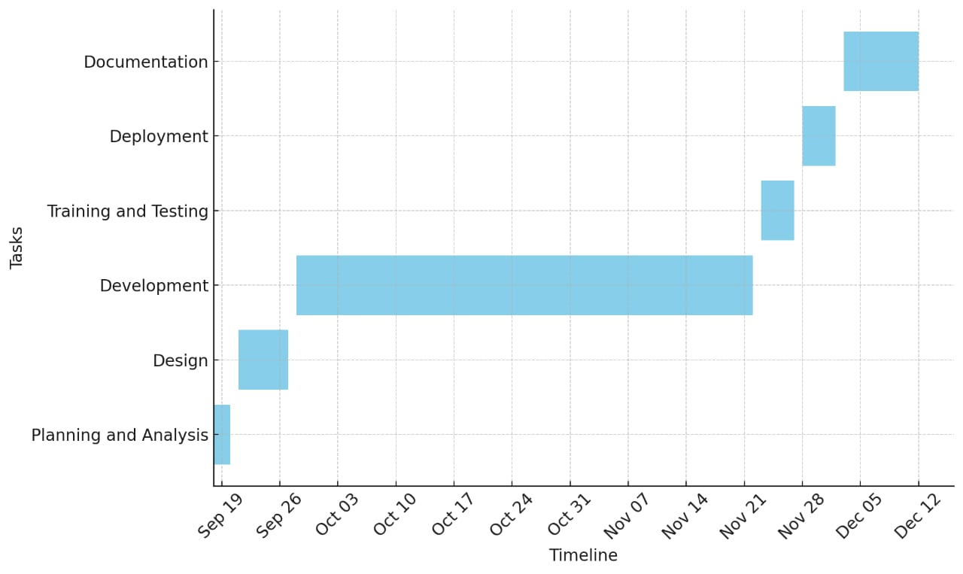
Timeline of Project

Slide 11
Outcomes/Results Obtained
Automated Query Resolution: Uses advanced NLP (e.g., BERT), ML, and structured knowledge repositories to deliver accurate, rapid responses with minimal human intervention. Generative AI ensures flexibility for unknown queries, improving reaction time, accuracy, and customer satisfaction.
Scalability and Feedback Loops: Learns from unresolved queries, updates the knowledge base, and adapts to changing user needs. Regular model upgrades (BERT, Generative AI) enhance accuracy and contextual understanding, reducing human reliance, lowering costs, and improving customer support.

Slide 12
Conclusion
Advanced Support: Efficiently handles inquiries, escalates complex issues, and learns from interactions.
Scalable & Cost-Effective: Manages multiple queries, reduces costs, and provides 24/7 service.
Continuous Improvement: Builds a knowledge base and enhances customer experience over time.
Long-Term Gains: Boosts productivity, optimizes resources, and supports business growth.

Slide 13
References
KATRAGADDA, V. (2023). Automating Customer Support
Patel, N., & Trivedi, S. (2020). Leveraging predictive modeling, machine learning personalization, NLP customer support, and AI chatbots to increase customer loyalty.
Nuruzzaman, M., & Hussain, O. K. (2018, October). A survey on chatbot implementation in customer service industry through deep neural networks.
Nguyen, T. (2019). Potential effects of chatbot technology on customer support:
Abouelyazid, M. (2022). Natural Language Processing for Automated Customer Support in E-Commerce: Advanced Techniques for Intent Recognition and Response Generation.
D'silva, G. M., Thakare, S., More, S., & Kuriakose, J. (2017, February). Real world smart chatbot for customer care using a software as a service (SaaS) architecture.
Iyambo, H. N., & Iyawa, G. (2023). Customer Support Chatbot to Enhance Customer Support Experience Using Machine Learning Techniques.
Suta, P., Lan, X., Wu, B., Mongkolnam, P., & Chan, J. H. (2020). An overview of machine learning in chatbots. International Journal of Mechanical Engineering and Robotics Research, 9(4), 502-510.[8]
Kumar, R., & Ali, M. M. (2020).
Kumar, N. K., Maheswari, K., Abinaya, A., Ramya, J., Ande, P. K., & Ramaian, C. P. (2024, April). Advancements in Chatbot Technology for Enhanced Customer Support in Online Retail.

Slide 14
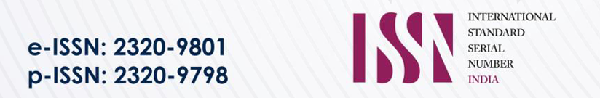

Publication Details
International Journal of Innovative Research in Computer and Communication Engineering
Volume 13, Issue 1, January 2025

Slide 15
Github Link
https://github.com/pavansreddy27/Customer-Support-Chat-bot-with-ML

Slide 16
Thank You

